Slide 1
UKIEPC 2022
Summary and solution outlines

Slide 2
Problem Solutions

Slide 3
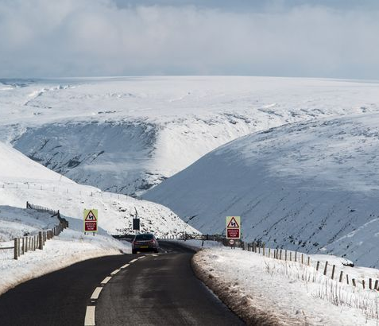
Alpine pass
Overview
Mountains are represented with contour lines.
How high into the mountains do we need to go if we want to travel from point A to point B?
19 correct • solved at: 01:31 by
lamelame
University of Oxford

Slide 4
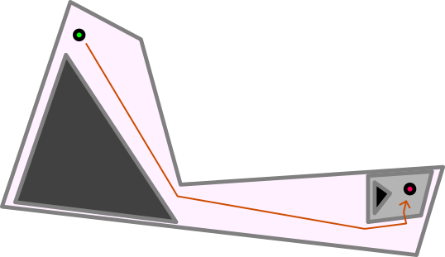
Alpine Pass
Techniques
Algorithm
Topology
Geometry
Key observation about contours:
If we are inside and our goal is outside, we need to cross.
If we are outside and our goal is inside, we need to cross.
Otherwise, we will never need to cross this contour.
So:
Find the lists of polygon contours containing the start
Find the lists of polygon contours containing the end
XOR the lists. These are the contours we need to cross.
We also need to take our start and end points into account, so find the smallest polygon enclosing each.

Slide 5
Boulder Wall
Overview
Find a set of routes up and down a wall
Multiple routes:
Must not touch horizontally
Must each consist of one colour
Individual routes:
Must start and end below h=100
Must reach above h=H
Must go strictly up + strictly down
Individual holds:
Must be at most 100cm apart
1 correct • solved at: 04:29 by
we <3 ronnie
University of Oxford

Slide 6
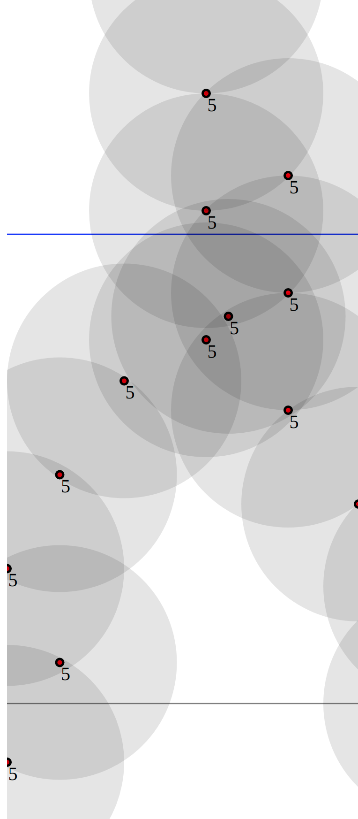
Boulder Wall
Techniques
Algorithm
Dynamic programming
Finger strength
Separate colours are irrelevant; split them up right away and solve individually
Assume we can get the optimal solution for a range of holds in x1…x2.
Use dynamic programming over this:
dp[T] = max(dp[u] + solve(u, T)] for all u < T
How do we calculate solve(u, T)?
Imagine the ascent and descent are actually going up at the same time, and (assuming up1 > up2):
dp2[up1][up2] = interest[up1] + max( max(dp2[up2][i] forall 0 <= i < up2), max(dp2[i][up2] forall up2 < i < up1))
Pitfalls:
Only link two nodes if distance² <= 10000
Need to introduce a special 0 node for “not used yet”
This node doesn’t care about distance, only height

Slide 7
Colour Mixing
Overview
The expression R:G:B gives us a ratio of three numbers.
We increase the values of R, G, and B one-by-one.
How many unique ratios do we have along the way?
63 correct • solved at: 00:00 by
TrinOl
University of Cambridge

Slide 8
Colour Mixing
Techniques
Algorithm
Fractions
Greatest Divisors
Keep a variable for the frequency of each of the three colours, and a hashset of ratios of colours each time.
Before we put a new element in the ratio hashset, we must reduce it to a canonical form. For example 6:12:9 could equally become 2:3:4.
We’ll create these canonical forms by taking the Greatest Common Divisor (GCD) of all three numbers
Classic recursive algorithm (shouting optional):
WHILE b > 0: (a, b) = (b, a MOD b)
RETURN b
In this case, brute force is also acceptable.
Print the size of the hashset at the end.

Slide 9
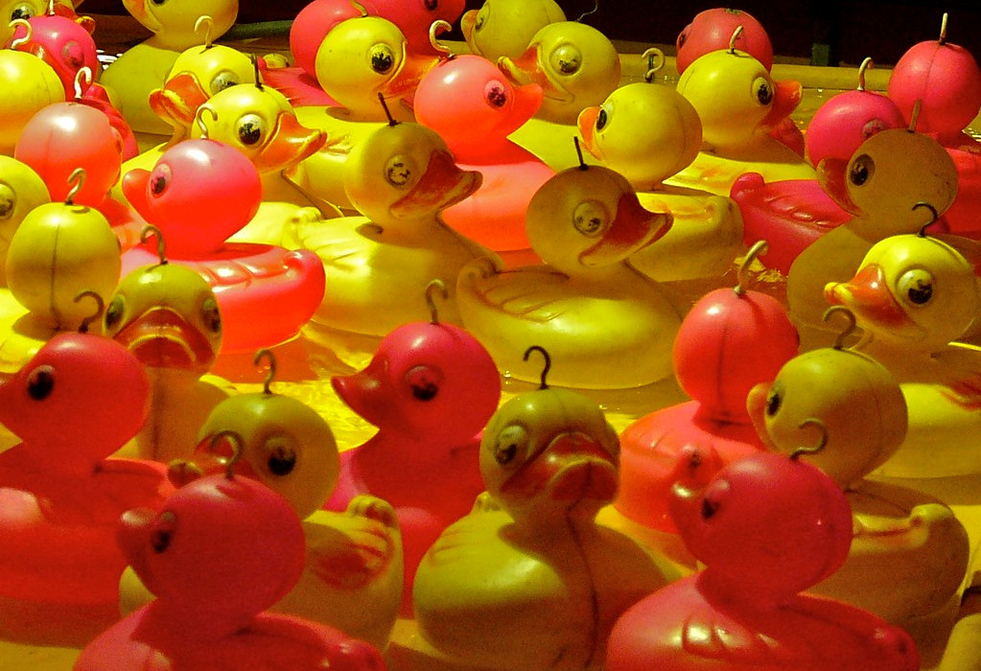
Duck Crossing
Overview
People are lined up on one side
Ducks are lined up on the other
People match with ducks
Each person needs to hook a duck
Hooks are not allowed to cross
How many phases of duck-hooking will we need to hook all the ducks without crossing hooks?
47 correct • solved at: 00:33 by
Placeholder Team Name
University of Oxford

Slide 10
Duck Crossing
Techniques
Algorithm
Sorting
Longest Increasing Subsequence
Consider ducks as (x, y) pairs. Sort them by x. The longest increasing subsequence is the most ducks we can have in one round at once (no inversions).
This can be found using Patience Sort, an algorithm which optimises the standard dynamic programming solution.
But what about the number of subsequences we need to make?
Look at the longest decreasing subsequence.
Every item must be in separate rounds, giving a lower bound.
The elements together can form an increasing subsequence covering the whole array, giving an upper bound.
Apply the same Patience Sort algorithm in reverse order.

Slide 11
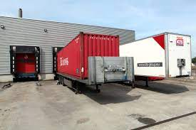
Eager Packing
Overview
We pack parcels into vehicles greedily, always putting the largest available in
There are N vehicles, and P parcels of various given sizes
How large must the vehicles be if we want to pack all of the parcels?
45 correct • solved at: 00:26 by
IMPostors
Imperial College London

Slide 12
Eager Packing
Techniques
Algorithm
Binary search
Amortisation
Assuming we’ve fixated on a given size per vehicle,
We need to repeatedly find the largest remaining element less than or equal to remaining capacity X.
We can use a sorted tree structure (eg. std::map or TreeMap) to keep track of counts, and to implement a nextLessOrEqual function
std::upper_bound(x)-1 in C++
floorEntry(x) in Java
Once this is done, binary search on the size per vehicle.

Slide 13
Fungible Growth
Overview
Two investment strategies, A, and B.
Gains of A = A% growth per year.
Gains of B = B% growth per year.
Which strategy should we use for our investments?
Assuming we want to make as much money as possible.
139 correct • solved at: 00:07 by
anonymous squids
University of Cambridge

Slide 14
Fungible Growth
Techniques
Algorithm
Input/Output
Nitrogen
Check whether A > B
If A > B, print A
If B > A, print B
It will never be the case that A = B, but in case it does, throw an exception like a good software engineer.

Slide 15
Grapheme Game
Overview
Each letter of the alphabet has a value.
We start the game with a long word.
Each player has to remove letters from the start and end of the word to leave behind a new one (or empty set).
Then the other player takes their turn, and again, and again, until there are no letters left.
You receive a score equal to the sum of values of the letters you removed.
What is the minimum score you can have if your opponent also plays to minimise score?
9 correct • solved at: 02:59 by
Holland King
University of Cambridge

Slide 16
Grapheme Game - Solution
Techniques
Algorithm
Aho-Corasick
Zero-sum games
Dynamic programming
Imagine an algorithm where we have 3 choices:
delete_start, delete_end: Remove a letter, consider next move
pass: (If the word is still valid) give the word to the opponent
Encode this function as a dynamic programming table:
For modifications: score[word] = (value[word]-value[word’]) + score[word’]
For handovers: score[word] = (value[word]-score[word]) if word in dict
The starting string has O(N^2) possible reductions, with O(N) letters each, so this is too slow.
However, only O(N) of the reductions correspond to words.
The words are connected by an Aho-Corasick graph.
For each word, its modified versions are close by in the graph:
Its fail-node is the result of removing letters from the start, and its parent is the result of removing a letter from the end.

Slide 17
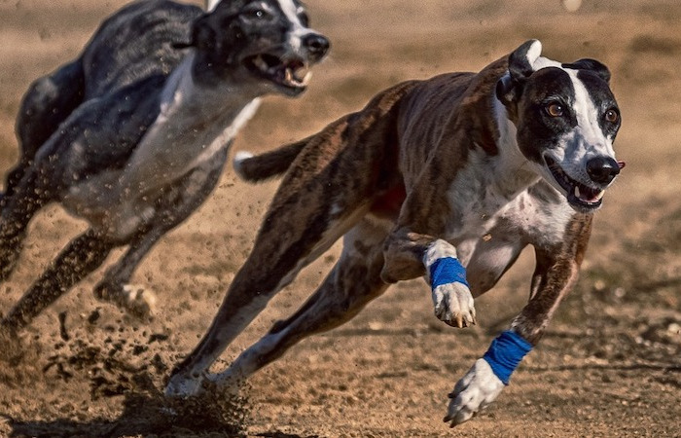
Hare’s Breadth
Overview
Greyhounds run from positions X[i] metres behind the starting line, at V[i] metres per second.
Over time, the identities and relative distances of the first and last place greyhounds will change.
At some time, the distance between first and last place is the minimum possible.
What is that distance?
26 correct • solved at: 00:23 by
we <3 ronnie
University of Oxford

Slide 18
Hare’s Breadth - Solution
Techniques
Algorithm
Lower Envelope
Sorting
The distance of the first-place at any time is on the upper envelope of the graph of distances travelled.
Likewise, the last-place dog is defined by the lower envelope.
The upper envelopes can be found with an algorithm similar to convex hull, but dealing with line segments, by sorting the dogs by starting position and inserting them at the end of the envelope polygon one-by-one.
Upper and lower envelopes are convex. Usually this means ternary search could give the closest place, however combining two envelopes may give us flat points in the graph.
Instead, check every interesting X coordinated defined by vertices on the upper or lower and use the envelopes to calculate Y-Y’ fast.

Slide 19
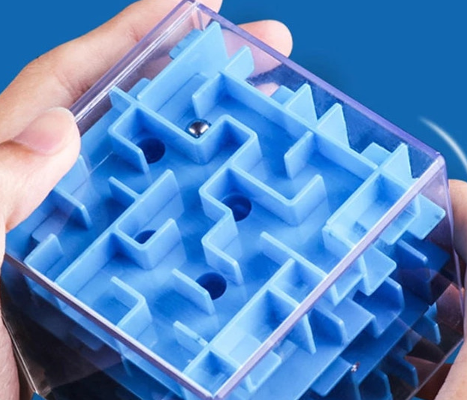
Incline Game
Overview
You can make one move in a maze by tilting in any cardinal direction, and a ball will slide as far as possible in that direction
Either into a wall,
Or into the target hole.
How many times do you need to tilt the board to win the game?
62 correct • solved at: 00:29 by
one more try
University of Edinburgh

Slide 20
Incline Game
Techniques
Algorithm
Shortest Paths
Generated Graphs
Split each cell (X, Y) into four:
(X, Y, West = travelling left
(X, Y, North = travelling up
(X, Y East = travelling right
(X, Y, South) = travelling down
If we are already travelling in direction D, then the cost of continuing to move from point (X, Y, D) to (X+x[D], Y+y[D], D) is zero assuming the cell is empty.
If the cell is not empty, then the cost of changing direction is exactly one. Add edges between (X, Y, D) and (X, Y, W/N/E/S) if D leads towards an occupied cell.
Run Dijkstra’s algorithm, or a hybrid depth/breadth-first-search, to find the shortest path on this graph.

Slide 21
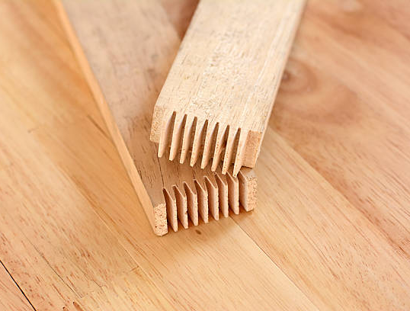
Joinery
Overview
Find two pieces of wood which, when laid lengthways, will have a total length of at least T.
If there are multiple, pick the pair with the smallest total.
73 correct • solved at: 00:04 by
ACMepted
University of Cambridge

Slide 22
Joinery
Techniques
Algorithm
Sorting
Two Pointers
Really, nodes of the same kind are not the same, we just need to go to any of them at some time T.
So we can make a table of cost_to_visit[T][NodeId] and only fill it in for the relevant kinds of node at time T.
Iterate through T in increasing order and do an all-pairs comparison to find if:
Station at T is valid to leave from
Station at T+1 is valid to go to.
Read off the minimum number in row T of the matrix at the end.

Slide 23
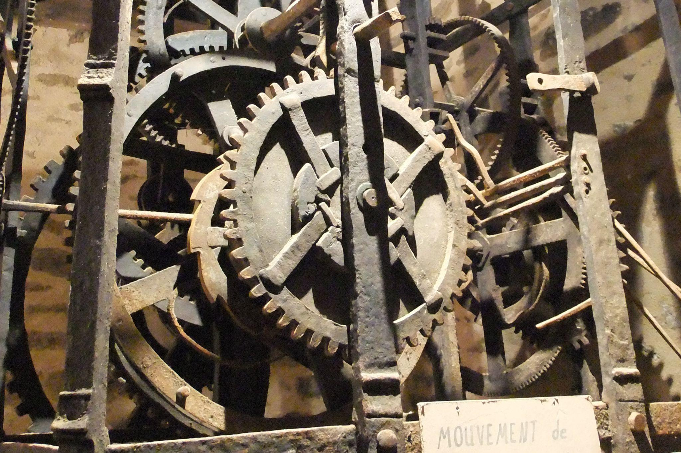
Keeping Time
Overview
Gears turn against other gears, imparting a spin in the opposite direction.
Sometimes, two gears share an axle and turn at exactly the same speed
Sometimes, a loop of gears forms and either matches or breaks an existing set of relations.
Are all of the gears in a given configuration able to turn freely?
36 correct • solved at: 01:30 by
we <3 ronnie
University of Oxford

Slide 24
Keeping Time
Techniques
Algorithm
DFS
Integer Fields
Chinese Remainder Theorem
If two gears are connected on the same axle or by meshing, the speed of one is a simple multiple of the other:
Same axle: v[b] = v[a]
Meshing: v[b] = v[a] * -(r[a] / [r[b])
In short, we can run a DFS keeping track of the velocity of each gear relative to the first gear found on the DFS.
In case of visiting the same gear more than once in a DFS, check that the newly-calculated speed is the same as the old one.
Problem: the constraints mean that the numbers involved can be huge, or tiny, and we need perfect accuracy.
Solution: store speeds modulo multiple large randomly-chosen primes, a la Chinese Remainder Theorem.
Notes:
This solution is wrong.

Slide 25
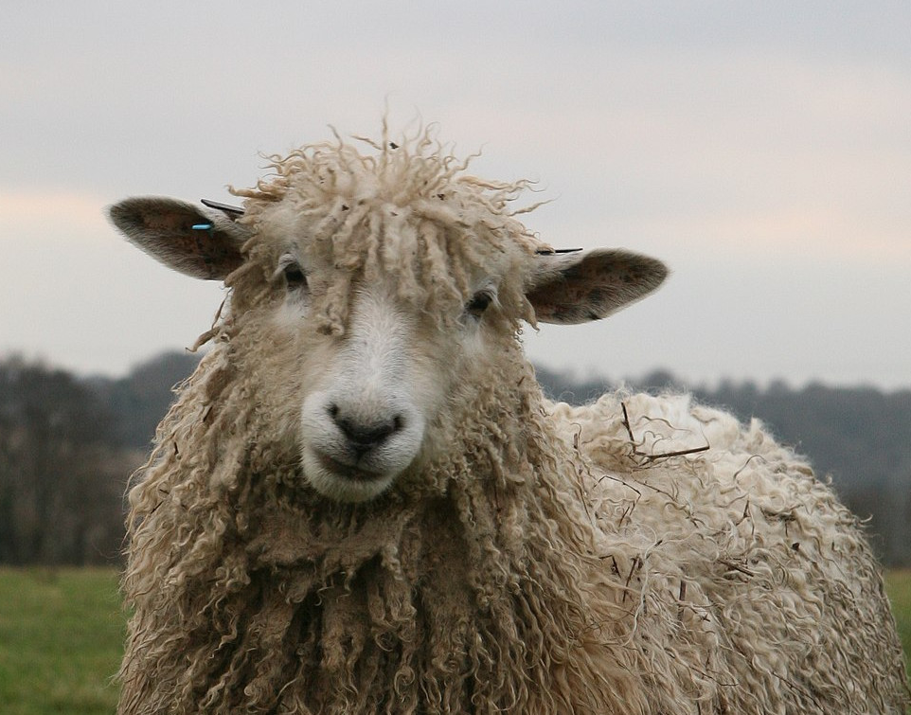
Lasso
Overview
Create one or more hulls fully containing N cells of a grid so that they can’t get out of the grid.
The line segments of the hulls can be 0, or 45, or 90 degrees from the horizontal.
1 correct • solved at: 04:31 by
Trinity’s Trinity
University of Cambridge

Slide 26
Lasso
Techniques
Algorithm
Maximum Flow
For the pure axis-aligned version of this problem, we’re looking for the minimum cut separating the outside edges from the sheep fields.
Draw a 1-edge from every field to its 4 neighbours.
Draw an ∞-edge from the source to each border edge.
Draw an ∞-edge from each sheep field to the sink.
The edges represent the necessity of removing every possible path from the border to the sheep fields, without removing the sheep fields or the borders themselves.
With 0/45/90 degrees the problem is similar. Split each field into 4 parts, diagonal edges cost=√½ and straight edges cost=1.
With some more geometry and time complexity, this can be adapted for any angles since only O(N^2) lines are special.

Slide 27
Final Standings
http://ukiepc2022.cloudcontest.org/

